Slide 1
Disability Access and Libraries –
Current Issues and Future Directions
Kate Deibel, Inclusion & Accessibility Librarian
Syracuse University Libraries

Slide 2

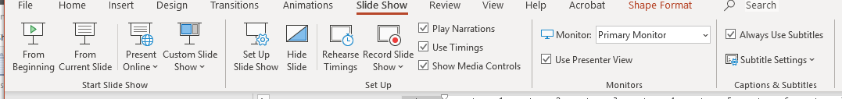
The Elephant Under the Slides
Assuming all is working, live captioning should appear below this slide and all others.
This is an AI feature found in Office 365 for PowerPoint.
It’s not perfect and provides no transcripts, but let’s give it a whirl.

Slide 3
Introducing Myself: My Job
I am the Inclusion and Accessibility Librarian (first position of its kind) at Syracuse University Libraries.
Duties include:
Critical leadership role in fostering an inclusive culture and expanding the Libraries’ accessibility services
Guiding and supporting efforts to promote inclusion and accessibility including planning, assessment, and advocacy
Be the Libraries' expert on accessibility and oversee the Libraries’ assistive technology and accessibility services

Slide 4
SU Libraries and Accessibility
The Libraries are committed to making our library resources available and usable to all patrons regardless of abilities.
We are viewed as cutting edge among other academic libraries.
However, we do not have all the solutions and it is critical to understand what support we can and cannot provide.

Slide 5
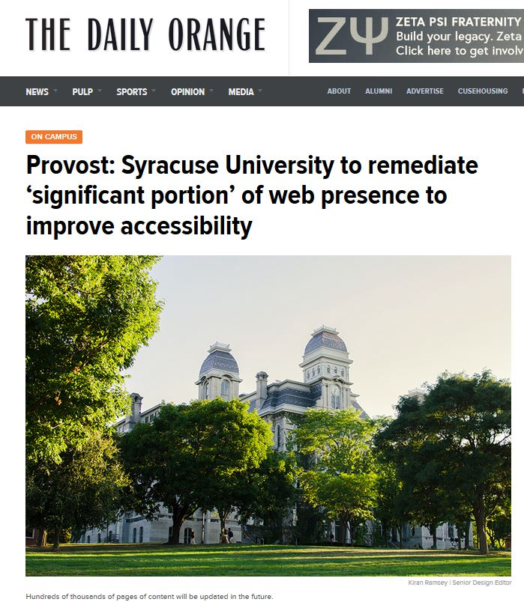
Office of Civil Rights Accessibility Complaint (1/2)
In late 2017, the Department of Education’s Office of Civil Rights issued an accessibility complaint to Syracuse University.
This triggered a comprehensive audit and remediation of all of our web content:
Library website…
Discovery systems…
LibGuides…
Repositories…
All online Word, PowerPoint, and PDF files…

Slide 6
Office of Civil Rights Accessibility Complaint (2/2)
Remediation took a massive collective effort over two months:
Held 41+ total open lab hours for accessibility trainings/consultations
Cleanup led to 100s of documents being remediated or removed
3000+ accessibility issues removed from our LibGuide pages
Two archives (Pan Am 103 and SURFACE) redesigned for accessibility
This was a comprehensive effort that no single person could have completed in that time frame.
Still, many thanks go to our then web librarian, Pam Thomas.

Slide 7
A Great Paper I Recommend (1/2)
"The Invisible Client: Meeting the Needs of Persons with Learning Disabilities"
by Darlene E. Weingard

Slide 8
A Great Paper I Recommend (2/2)
The paper covers a wide array of topics:
Describing the user population
Providing examples of some libraries' current efforts
Distinguishing between support for children and adults
Highlighting current and new technologies than can help
Listing existing issues for libraries to address as a community.
But I said there was a punchline…

Slide 9
Thirty Years of the Same Advice
Full citation:
Weingand, D. E. (1990). The invisible client: Meeting the needs of persons with learning disabilities. The Reference Librarian, 14(31), 77-88.
I could take this article, update some of the references to technology and laws, and easily get this republished.
This paper is a symptom of a larger issue in accessibility advocacy.

Slide 10
The Problem
Much of accessibility advocacy focuses on just teaching the basics.
We need to engage in more efforts at all levels of accessibility.

Slide 11
To be clear
I am now saying we should stop all webinars, tutorials, workshops, presentations, etc. that teach the basics of web accessibility.
Such trainings give us the advocates, allies, and armies we need to put forth accessible change.
The "problem" is that we need to start putting these interested parties to use in this battle.

Slide 12
And a note
It's really hard to avoid war metaphors when discussing the need to take action on accessibility.
Please forgive my passion making it hard to find better words.

Slide 13
Understanding the Challenges
Before we can discuss what Libraries can or should be doing for an accessible future, we need to discuss the reasons behind accessibility being so challenging.

Slide 14
Challenge: Accessibility is BIG (1/3)
Consider the Library and all the parts that need to be accessible:
Our physical spaces
Our people
Our holdings
Our technology

Slide 15
Challenge: Accessibility is BIG (2/3)
But now refine those areas further:
Our physical spaces
  Entrances
  Stacks
  Bathrooms
Our people
  Patrons
  Staff
Our holdings
  Physical
  Electronic
Our technology
  Hardware
  Homegrown applications
  Vendor applications

Slide 16
Challenge: Accessibility is BIG (3/3)
We have many working parts with further working parts underneath.
We have multiple stakeholders involved both internal and external to the libraries.
Each part has different challenges to address.
It's easy to be overwhelmed.
And oops, we forgot to mention accessibility in services, policies, events, and probably a lot more aspects too.
Library accessibility requires the whole library!

Slide 17
Challenge: Disability is Diverse
We break down disability often by type (mobility, sensory, cognitive) but each individual exhibits a gamut of strengths and difficulties.
What does it mean for something to be truly accessible?
Must everything work for everyone?
There are reasons we talk about reasonable accommodations.

Slide 18
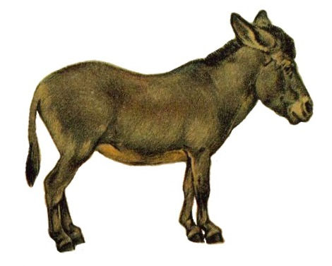


Challenge: Carrot versus Stick
We often have to push people to make things accessible:
  Carrot Method:
  Accessibility is a good thing
  Stick Method:
  Punishment if you don't
People prefer the carrot method but we often get agreement but no follow-through. Stick gets follow-through but complaints.
Notes:
Mule: https://commons.wikimedia.org/wiki/File:NIEdot332_white_background.jpg
Carrot: https://pixabay.com/en/carrot-vegetable-cultivate-2985399/
Stick: https://pixabay.com/en/branch-stick-wooden-tree-plant-34379/

Slide 19
OCR New Cases by Month (March 2014 – March 2019)
Accessibility cases for Postsecondary Institutions https://www2.ed.gov/about/offices/list/ocr/docs/investigations/open-investigations/dis1.html

Slide 20
More Cases, More Complaints
Despite differing priorities from the presidency, the Office of Civil Rights are increasing the number of cases they oversee.
They’re managing this by changing how they handle cases.
Previously:
OCR confirms complaint
OCR performs audit
University must respond
Ongoing talks
Now:
OCR confirms complaint
University is given heads up to perform audit and improve
University must responds by given date to show permanent changes

Slide 21
The Odds Say…
You should get ready for WHEN not IF an accessibility complaint comes your way…

Slide 22
Challenge: So Many Accessibility Myths
MYTH: If a product is inaccessible, we can’t ever use it.
  Reasonable accommodations suffice, and some exceptions exist.
  When should we start burning our books?
MYTH: Accessibility standards are objective and unbiased.
  They are based on lab settings under strict controls.
  Humans and usage contexts vary.
  WCAG overwhelmingly addresses visual issues and has little to say about cognitive disability.

Slide 23
Challenges aside, to the future
With the challenges in mind, how do we ensure disability access in libraries?

Slide 24
A simple step
Do you know what the #1 thing you can do right now to make library spaces more accessible?

Slide 25
Always Use the Microphone (1/3)
An accessible library future means we always use the microphone whenever one is available:
At conferences
At large staff meetings
At campus events

Slide 26
Always Use the Microphone (2/3)
Benefits:
Supports many people with auditory and attentional issues
Benefits people with temporary hearing issues
Multiple sound outputs as opposed to a single mouth
Is a first step to live captioning (advocate for that next!)

Slide 27
Always Use the Microphone (3/3)
But we need people to advocate for microphones:
Demand sound systems, especially for conferences
Fund support for personnel and ongoing technology maintenance
Give trainings on how to use a microphone and running systems

Slide 28
Small changes are only the beginning
Any library person can advocate for microphone usage.
It's a small change with big implications.
But we can do more with the right actions.
That's what I'm here to discuss today.

Slide 29
The Rest of This Talk
The rest of this talk focuses mostly on what we do at SU Libraries.
Before that, let’s speak briefly about library buildings and people.

Slide 30
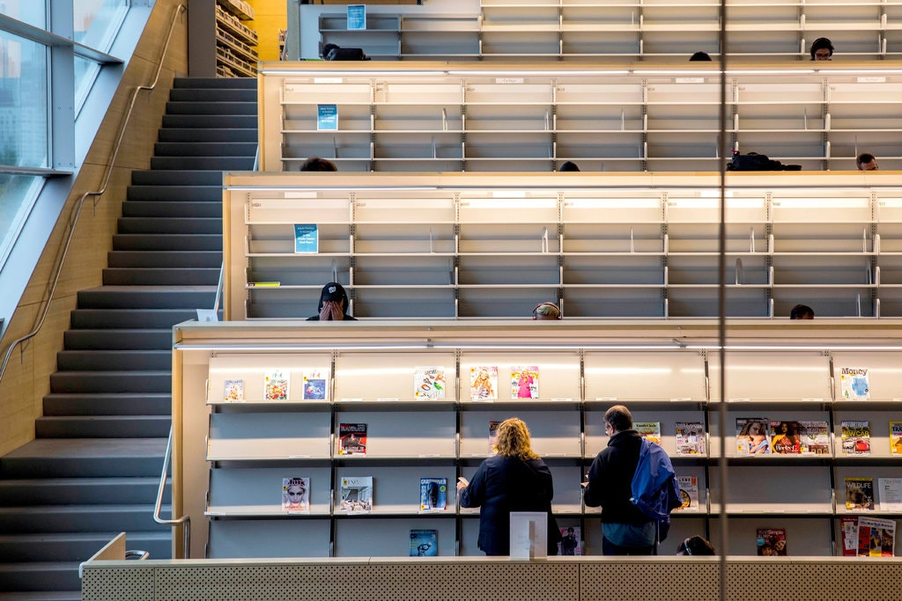
The Inaccessible Library of Long Island City
The brand new $41.5 million public library in Long Island City is an accessibility abomination:
Inaccessible shelving
5-story building with ONE elevator
Designers are ignoring the issue:
“To be honest, we hadn’t thought, ‘O.K. we have to provide an exactly equivalent browsing experience. This will be a new standard for libraries, and that’s great. But that doesn’t mean it’s a flaw in the design. It’s an evolution.”
https://www.nytimes.com/2019/11/05/nyregion/long-island-city-library.html

Slide 31
Library Buildings – The New
The American with Disabilities Act (ADA) was passed 29 years ago.
There is no excuse now for new buildings to lack ramps, motorized doors, accessible restrooms, elevators, and more.
It still happens though. You can prevent it:
  Involve disabled patrons and staff in building design reviews from the start (easier to catch hard to undo errors early!)
  Treat the ADA guidelines as a minimum. Aim to go beyond.

Slide 32
Library Buildings – The Old
You can learn to make any existing buildings better. You just need to ask the right people.
Ask disabled patrons do accessibility reviews of key locations:
  Can a blind patron navigate from entrance to the info desk?
  Are the stacks wide enough to accommodate wheelchairs?
  Is the modular furniture always left in a chaotic mess?
  Do your Braille signs say what you hope they say?

Slide 33
Learn from your Patrons
Last January, we held a staff training in which a panel of library patrons with disabilities discussed their experiences at SU Libraries.
  Most attended training we have ever had
  The audience AND panelists stayed late for more discussion
  Lots of ideas generated (just need to follow through)
Lesson: Learn from your patrons

Slide 34
Staff are People Too
Accessibility applies to all people, including library staff.
Do not neglect them when considering:
  Designing accommodation policies
  Purchasing furniture
  Adopting software
Most importantly, respect work-life balance and promote self-care and well being for physical and mental health.

Slide 35
What We Do at SU Libraries
So what are some of the ways SU Libraries strives for increased accessibility to our patrons and staff?

Slide 36
Services for Faculty

Slide 37
Syracuse University ICT Accessibility Policy
Information and Communication Technology (ICT) Accessibility Policy
Went into effect on January 1, 2018
All new ICT purchases must meet Section 508 / WCAG 2.x AA
Renewals of licensed ICT products must also meet standards
Services associated with technologies must be accessible
All course materials should be accessible per standards

Slide 38
Faculty commonly ask
Can you do any remediation for us?

Slide 39
Our Limits
At this time and probably never, SU Libraries cannot perform remediation (and training on) of classroom materials, even if they were procured them from the Libraries.
We lack the funding, resources, and bandwidth
We are much more strict on copyright and fair use
Accessibility is everyone’s responsibility
Our focus is on patrons with disabilities

Slide 40
Office of Disability Services or Libraries?
Still, the Libraries does provide remediation depending on the nature of the course material if there is a student with a documented print disability indicating an accommodation need.
Who does the remediation depends on the nature of the material:
If the course material is being used by all students, then contact ODS about getting the file remediated
If the material is supplementary (e.g., choose you’re a book), then the Libraries can provide a remediated version through our Alternate Format Service

Slide 41
A second plea from faculty…
Any other help for us?

Slide 42
Improving Course Materials
Remediating an old scanned copy is nigh impossible, so try finding a newer copy to work with.
If you have difficulty, contact your subject/liaison librarian for help: https://library.syr.edu/staff/subjects.php

Slide 43
Accessible Physical Course Reserves
Starting to proactively remediate all physical items placed on course reserves in case students need accessible versions
Still figuring out how to handle checkout of remediated versions:
  Maintaining a list at circulation as to who is eligible for access?
  Different checkout durations to account for disability?
  What about copying of material?

Slide 44
Services for all Patrons

Slide 45
Assistive Software
All computers within SU Libraries comes pre-installed with assistive software to support disabled patrons, including
JAWS screen reader and ZoomText magnifier
Read & Write Gold
Microsoft Accessibility Suite
Eventually, we plan to improve entry points on these PCs for easier use by patrons with disabilities.

Slide 46
Bird 123 – Assistive Technology Space
Room 123 in Bird Library is our assistive technology space where we have additional technologies to further assist disabled patrons.
Room 123 is also a venue for educational tours about what assistive technologies are and how they work.
Currently planning and budgeting for a scanner to support instructors and TAs in producing accessible course materials.

Slide 47
Shelf Retrieval Services
Patrons can request that a library staff member fetch an item from the library shelves at any time.
Already existed prior to policy but has new value.
Still lacks the benefit of browsing the shelf to find other titles.

Slide 48
Alternate Format Service
SU Library patrons with print access needs can request accessible versions of any print item the library owns or can request.
Convert a printed book into an accessible ebook
Provide an accessible PDF of a journal article
Scan a chapter from a book
Cost to the patron: FREE

Slide 49
Origins
Started by Ron Figueroa (ILL Manager) and Stephanie Helsher (now at Upstate University) the year before I started
The few equivalent programs we know of include one limited effort at UC Berkeley libraries and the Ontario academic libraries’ Scholars Portal

Slide 50
Requirements and Signing Up
An SU patron must be registered as being eligible for receiving print accommodations with ODS or EOIRS
Agree that a referral letter can be sent to SU Libraries informing of the patron’s eligibility.
Patron creates an Interlibrary Loan Services (ILLiad) account at SU Libraries: https://illiad.syr.edu/

Slide 51
How to Request an Alternate Format
Sign on to ILLiad at https://illiad.syr.edu/
Choose the type of material you want to request:
  Article or Book Chapter
  Book, Report, or Audiovisual
Fill out the form with information about the item
Select what Disability Accommodation you want:
  Scan Book Only
  Standard Text Recognition
  Full Edit
Submit Request

Slide 52
Alternate Format Types
Scan Book Only:
A scanned PDF. Text is not selectable. Ideal for magnification.
Standard Text Recognition:
PDF with selectable text. Can be listened to with many applications, including Read & Write Gold.
Full Edit:
PDF remediated to the accessibility standard, including headings and image descriptions. Best for screen reader users.

Slide 53
After You Submit A Request
SU Libraries will contact you soon about your request and to maybe ask for clarification on your request.
Delivery times vary but we will do our best to keep you updated.
Once the item is available, you will receive an email notification.

Slide 54
Recent Changes to Process and ILLiad
Some referral letters are coming in!
New ILL supervisor: Kristin Jeter
Detailed workflow and responsibility for various individuals
Recent updates to ILLiad interface: (amazing!!)
  Fixes for accessibility (i.e. required attributes, tabindex fixes)
  Much larger font size!!
Joined and promoting national ILL agenda to OCR all loans that are scans

Slide 55
Upcoming Changes
ILLiad will be upgraded to version 9 with new interface
  Greater responsiveness
  Greater WCAG 2.1 AA conformance
Improved advertising of service for sharing across units
Move to newer ILLiad set up where:
  Accommodation request options only show for registered users
  Multiple avenues for signing up included

Slide 56
Caveats about Our Reforming Services
Remediation is mostly done through third party vendors
Requires strong communication workflows with campus disability services for eligibility
Lots of erroneous requests
Delivery time is slower than desired (ILL + remediation time)
Increased concerns about copyright and fair use
Currently funded but not sustainable

Slide 57
Speaking of Bookshare…
What about sustaining funding for reformatting?
Can all libraries do this?
What about expertise and technology needed?

Slide 58
What is Bookshare?
Bookshare is an amazing non-profit that provides accessible texts:
  Has negotiations with many publishers to maintain a repository of remediated fiction, K-12 textbooks, magazines, etc.
  Holdings are of less use in higher education
  Only open to people who can demonstrate proof of a print disability (visual disability or reading disability but not ADD)
  Catalog could use some librarianship (i.e. better metadata, feeds for sharing with other discovery systems)
Could libraries do this too?

Slide 59
Repositories of Remediated Materials
We cannot continue with redundant remediation efforts.
We need to somehow share these efforts while respecting rights.
Can we do this? Some are trying (and succeeding):
  The Council of Ontario Universities' Accessible Content Portal shares remediated texts to eligible students in their system
  Recent Mellon Grant for "Federating Repositories of Accessible Materials for Higher Education" for several university libraries is underway. Let by John Unsworth (VCU) and others.

Slide 60
Going further with the idea…
What if for journal articles, we push up to the publishers the versions we remediate?
This makes the accessible versions available to everyone via their own systems.

Slide 61
The Crux of the Challenge
Copyright, fair use, and accessibility are a complex legal matter.
ARL recently published a comprehensive white paper on this issue.
Still, it boils down to publishers and their licensing.

Slide 62
Accessibility of Third-Party E-Resources
For every new resource we solicit, we ask for a VPAT or accessibility review of the product.
Most companies have out-of-date or incomplete VPATs/reviews
By asking, we remind vendors that accessibility is important
Use the Big Ten’s recommended accessibility license language
We have also begun doing some assessments of our own:
MLIS intern performed screen reader reviews of e-book and journal databases in cooperating with relevant subject librarians
Automated web crawling tests of basic accessibility needs

Slide 63
The Vendors and Their Content (1/2)
There's a wise saying in educational accessibility circles:
"There's no point in building a state-of-the-art
inclusive classroom on the third floor of a
building with no elevators."

Slide 64
The Vendors and Their Content (2/2)
While we would eventually want vendors to make their articles, journals, databases, and more accessible, they still need to make their websites accessible.
We can't simply shop for a more accessible alternative due to the strangleholds we see from many of the big parties.
This will require coordination of many libraries to push for change.

Slide 65
More to Discuss
Libraries will need to act on accessibility in many other areas that I
sadly lack the time to go into detail:
  Format Accessibility Standards:
  Did you know the PDF standard has no support for footnotes?
  Open Educational Materials:
  Why should any OER materials go out without being compliant?
  Repositories, special collections, archives:
  Who bears the responsibility of creating accessible content?
  Are the standards sufficient to support patrons?

Slide 66
In Conclusion
Please, push for accessibility changes no matter how small or big.
I gave my first library talk at Code4Lib 2015 in Portland Oregon. I wish to end with how that talk started:
Web accessibility is important.
If you disagree… you're WRONG!

Slide 67
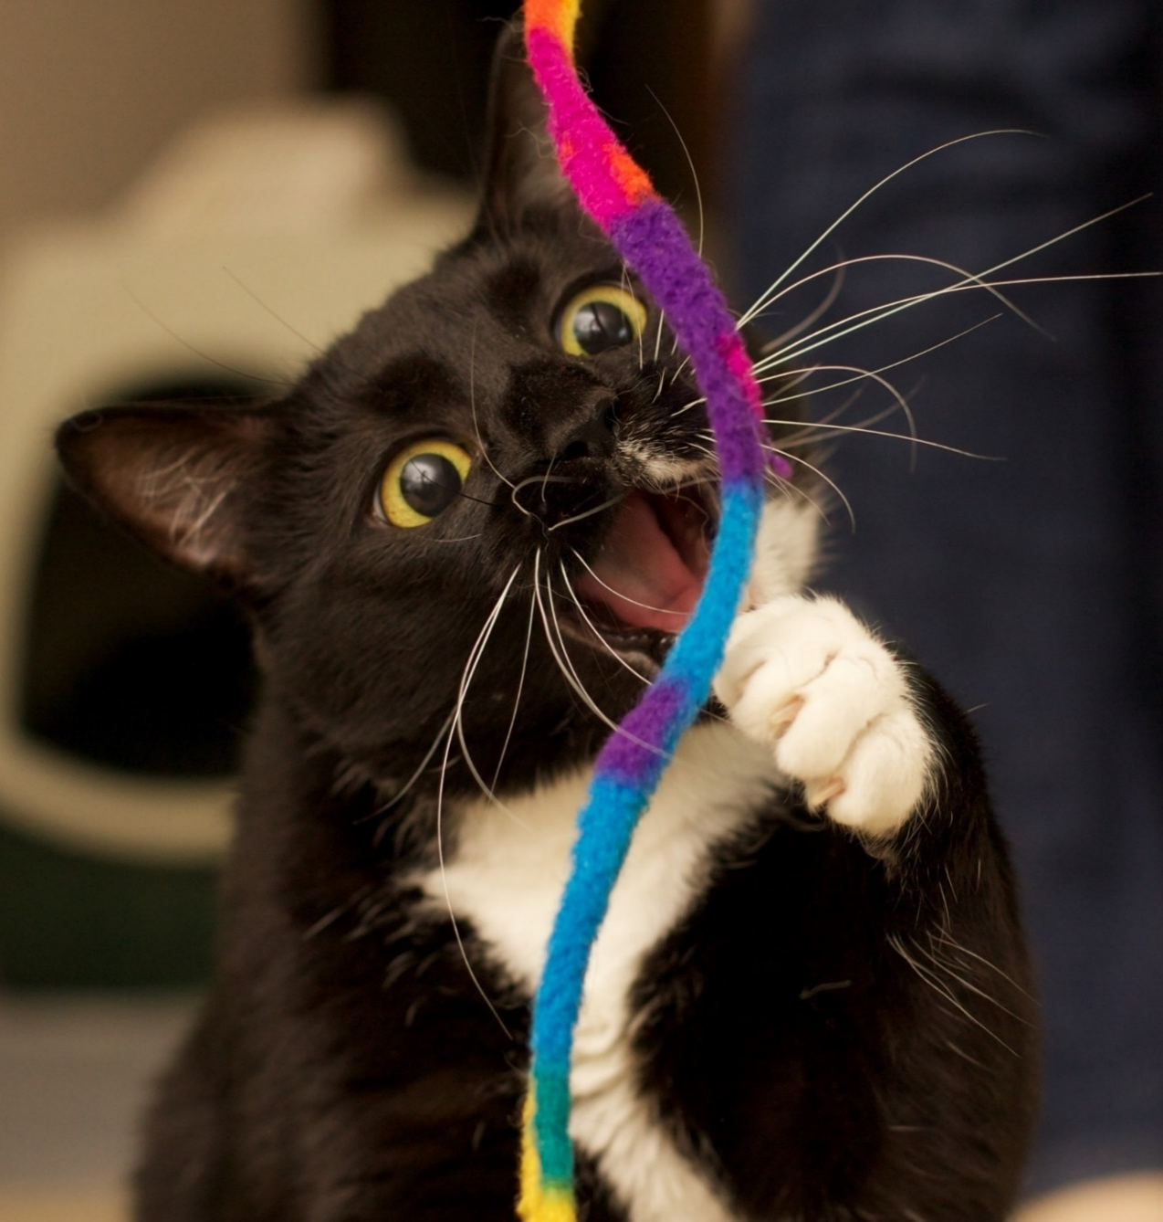
Questions
Kate Deibel, PhD
Inclusion & Accessibility Librarian
Syracuse University Libraries
Email: kndeibel@syr.edu
Twitter: @metageeky
URL: https://library.syr.edu/accessibility
Questions?
This slide deck is distributed under a Creative Commons Attribution 4.0 International License except where indicated for individual images.

Slide 68
Additional Slides:
Basics of Keyboard Testing

Slide 69
Web Accessibility: Important but Tricky
Web accessibility is important.
If you disagree… you're WRONG!
Some accessibility requires expert knowledge
ARIA markup
Writing good ALT text
Knowing how to use a screen reader
Here's a simple but critical accessibility test that any web user can do (not just developers).

Slide 70
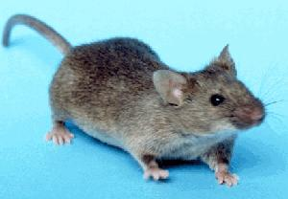
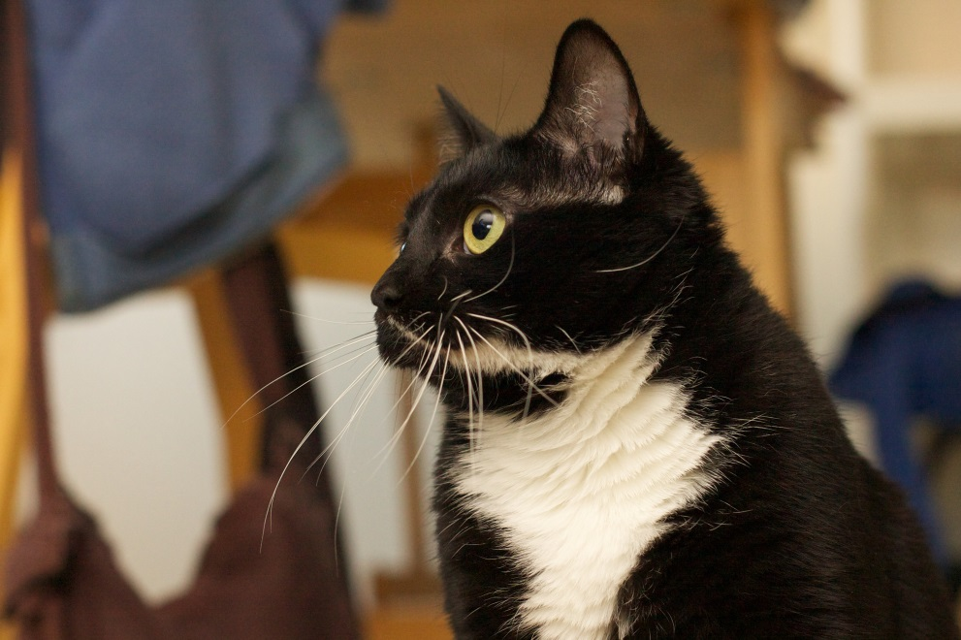
A mouse but then a cat appears…
Consider your mouse, touchpad, etc.
Imagine it's a real mouse…
… and you have a cat nearby

Slide 71
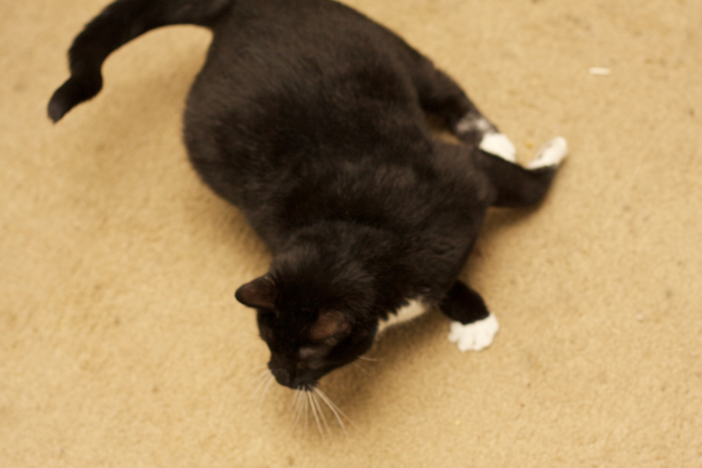
The cat chases the mouse
In other words…
YOUR MOUSE IS NO MORE!

Slide 72
How to test keyboard accessibility
Without the mouse, try to use the site using the keyboard:
Keyboard Key | What It Does
Tab | Move to next link, button, or form field
Shift + Tab | Move to previous link, button, etc.
Enter | Trigger current link or button
Space | Trigger interactive element (dropdown menus, buttons, checkboxes, etc.)
Up / Down | Navigate menus, choose radio buttons, adjust number inputs
Right / Left | Navigate menus, adjust sliders, etc.
Escape | Close menu or modal

Slide 73
Evaluating keyboard accessibility
Ask yourself:
Is it the same experience as using a mouse?
Can you navigate to everything on the page?
Can you manipulate everything?
Do you always know where you are?
Any hidden elements you can tab to?
Can you see those hidden elements?
Is the pattern of navigation smooth or chaotic?

Slide 74
A simple statement
This is keyboard accessibility.

Slide 75
Why Keyboard Accessibility Matters
When we think about web accessibility, we tend to focus on blind and low-vision users.
Physical impairments that impact mobility (fine and gross motor control) are more common:
Arthritis, Paralysis, Multiple Sclerosis, Lupus, ALS, Cerebral Palsy, Muscular Dystrophy, etc.
http://disabilitycompendium.org/
Prevalence of Types of Disabilities Ages 18-64 in the US (2013)

Slide 76
More Benefits of Keyboard Accessibility
Blind users and mice do not get along.
(no… blind people are not cats)
A keyboard accessible page will cooperate better with screen readers!
And there are even weird folks who like to mix it up between mouse and keyboard interactions.
(I am weird)

Slide 77
Awesomeness
Keyboard accessibility is awesome…
…but it can be even more AWESOME!!!

Slide 78
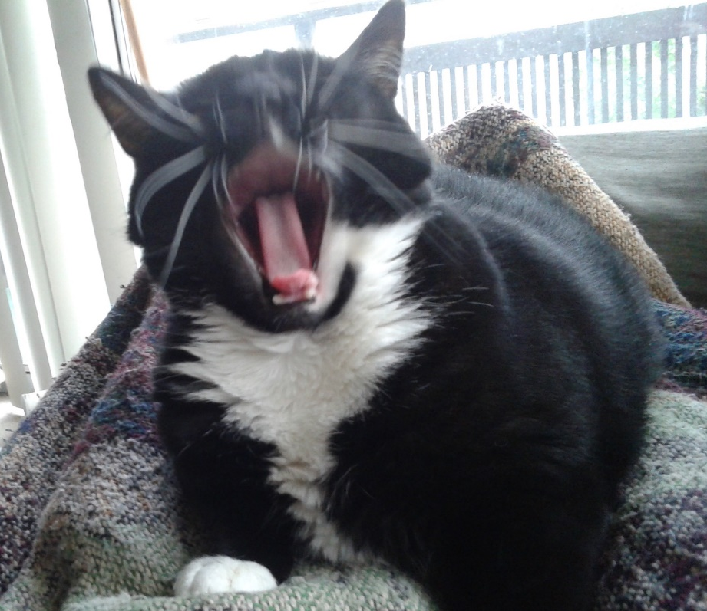
Are you serious?
MORE!?!
AWESOME?!?

Slide 79
A Challenge to You (and Vendors)
Imagine your local IT Services or a vendor offers up a new website and shows off its swanky new features…
Ask them “Is it accessible?”
No matter their answer, run a quick keyboard navigation check right then and there.
Hold them to meeting this basic tenet of accessibility.
Change the world.

Slide 80
Yes, change the world
Imagine hordes of librarians putting developers and vendors on the spot to provide accessible sites. GLORIOUS!!
But what if they ask how to fix it?
The answers are out there and here!

Slide 81
Web Accessibility Resources
WebAIM:
https://webaim.org/techniques/keyboard/
University of Washington Accessibility Guides: http://uw.edu/accessibility/checklist/keyboard/
The #NoMouse Challenge:
http://nomouse.org/
W3C ARIA Best Practices:
https://www.w3.org/TR/wai-aria-practices/#aria_ex

Slide 82
The Technical Details
Arrange HTML in the desired reading order
Use tabindex to control navigation order
Hidden elements (i.e. skip links) should appear when they gain focus
Use the :focus selector to indicate keyboard focus
All interactive elements (tooltips, dropdowns, modals) should respond to focus and key events
Use semantic elements like <a> and <button> and just
say NO to the onclick attribute.
Be careful when rolling out your own GUI widgets!!

Slide 83
To Summarize
A Simple Accessibility Test for All Users:
Try navigating your site with only the keyboard
Report and / or fix any problems
Accessibility and Usability for the win!

Slide 84
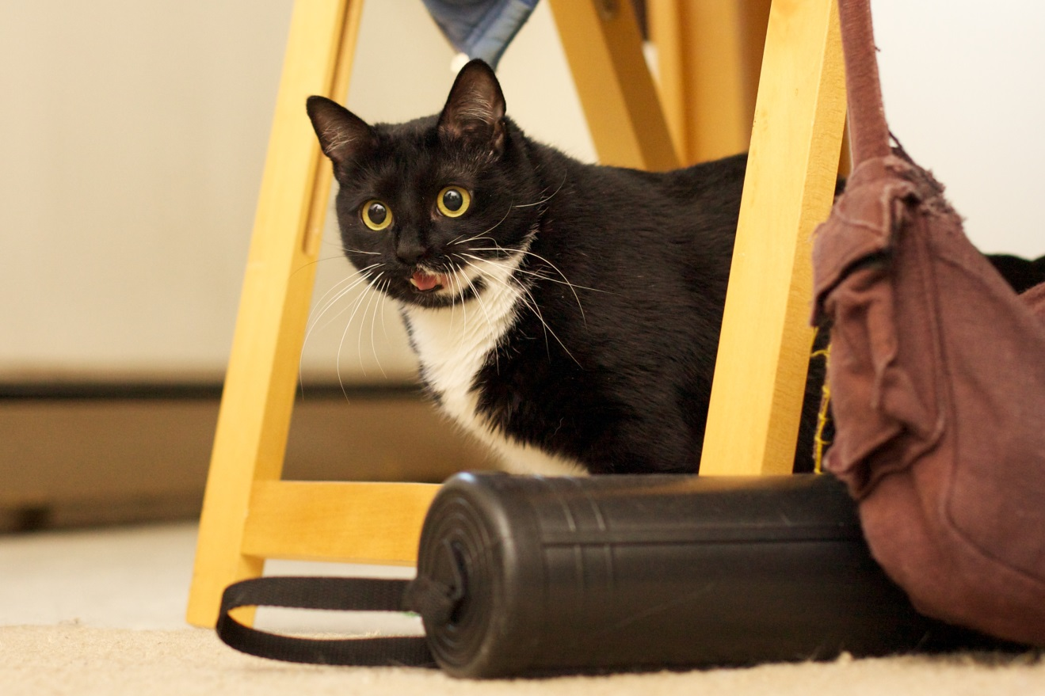
So remember...
NO MICE!!!

